Slide 1
Memory

Slide 2
Table of Contents
Memory
Memory Units
Classification of Memory
Memory Hierarchy
Memory based computer Architectures

Slide 3
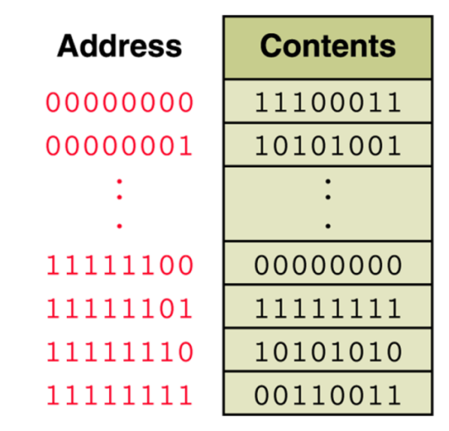
Memory unit
Storage device where the data and instructions are stored
An ordered sequence of storage cells, each capable of holding a piece of information
  Each cell has its own unique address
The information held can be input data, computed values, or your program instructions.
Notes:
Additional notes on memory
The computer starts using the memory from the moment the computer is switched on, till the time it is switched off. The list of steps that the computer performs from the time it is switched on are—
1. Turn the computer on.
2. The computer loads data from ROM. It makes sure that all the major components of the computer are functioning properly.
The computer loads the BIOS from ROM. The BIOS provides the most basic information about storage devices, boot sequence, security, plug and play capability and other items.
3. The computer loads the OS from the hard drive into the system’s RAM. CPU has immediate access to the OS as the critical parts of the OS are maintained in RAM as long as the computer is on. This enhances the performance and functionality of the overall system.
4. Now the system is ready for use.
5. When you load or open an application it is loaded in the RAM. Since the CPU looks for information in the RAM, any data and instructions that are required for processing (read, write or update) is brought into RAM. To conserve RAM usage, many applications load only the essential parts of the program initially and then load other pieces as needed. Any files that are opened for use in that application are also loaded into RAM.
6. The CPU requests the data it needs from RAM, processes it and writes new data back to RAM in a continuous cycle. The shuffling of data between the CPU and RAM happens millions of times every second.
7. When you save a file and close the application, the file is written to the secondary memory as specified by you. The application and any accompanying files usually get deleted from RAM to make space for new data.
8. If the files are not saved to a storage device before being closed, they are lost.
The memory unit is the part of the computer that holds data and instructions for processing. Although it is closely associated with the CPU, in actual fact it is separate from it. Memory associated with the CPU is also called primary storage, primary memory, main storage, internal storage and main memory. When we load software from a floppy disk, hard disk or CD-ROM, it is stored in the memory unit.

Slide 4
Memory unit
The computer memory is measured in terms of bits, bytes and words.
A bit is a binary digit either 0 or 1.
A byte is unit of memory and is defined as sequence of 8 bits.
The word can be defined as a sequence of 16/32/64 bits or 2/4/8 bytes respectively depending on the machine architecture
Notes:
Additional notes on memory units
The computer’s memory stores data, instructions required during the processing of data, and output results. Storage may be required for a limited period of time, instantly, or, for an extended period of time. Different types of memories, each having its own unique features, are available for use in a computer. The cache memory, registers, and RAM are fast memories and store the data and instructions temporarily during the processing of data and instructions. The secondary memories like magnetic disks and optical disks have large storage capacities and store the data and instructions permanently, but are slow memory devices. The memories are organized in the computer in a manner to achieve high levels of performance at the minimum cost.

Slide 5
Computer memory classifications
Main memory-Primary storage
Secondary memory-Auxiliary storage
Cache memory

Slide 6
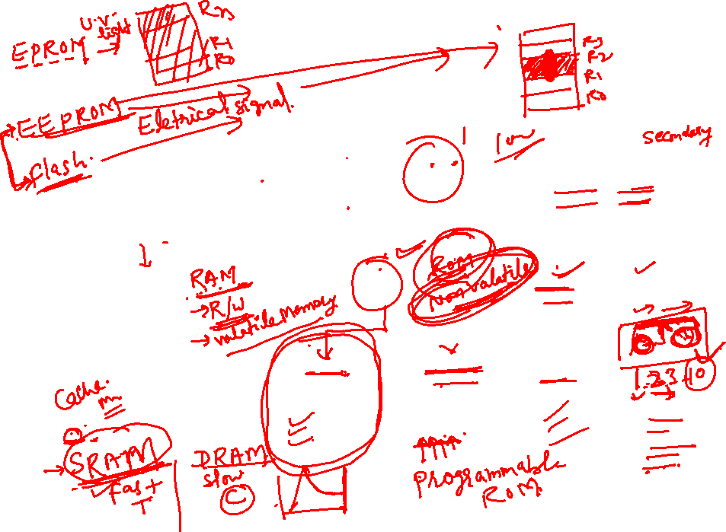
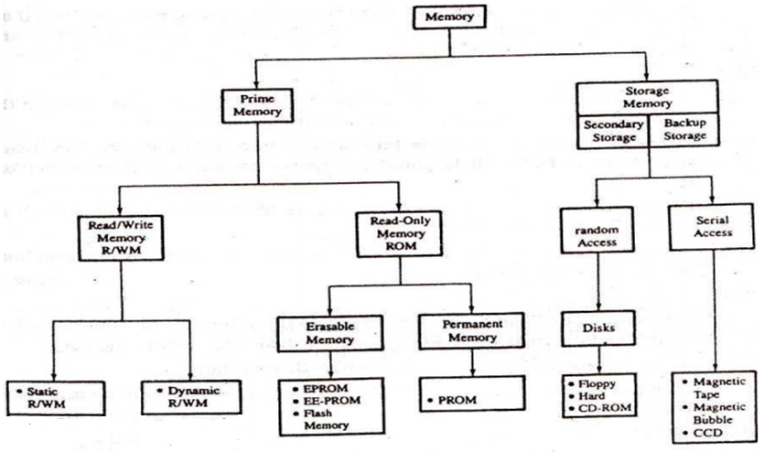

Computer memory classifications cont..

Slide 7

Primary storage: RAM & ROM
RAM stands for Random Access Memory
  Read and write memory
  Information typed by the user are stored in this memory
  Any memory location can be accessed directly
  During power failure the information stored in it will be erased → volatile memory
ROM stands for Read Only Memory
  Permanent memory and non volatile
  Contents in ROM can not be changed

Slide 8
Secondary memory
Non-volatile memory
Made up of magnetic material
Stores large amount of information for long time
Low speed
Holds programs not currently being executed
Notes:
Input, output, and auxiliary/secondary storage devices attached to a computer are called peripherals. E.g. Magnetic tapes, magnetic disks, compact disks etc.

Slide 9
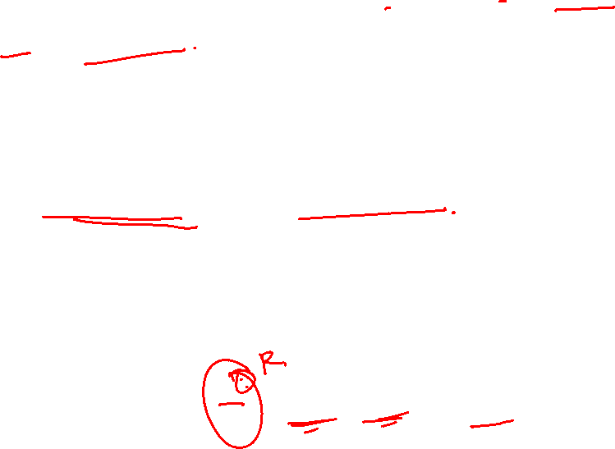
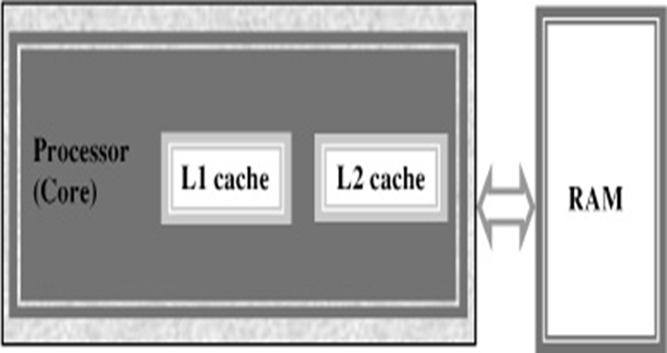
Cache memory
High speed memory placed between CPU and main memory
Stores data and instructions currently to be executed
More costly but less capacity than main memory
Users can not access this memory
Notes:
Additional notes on cache memory
The data and instructions that are required during the processing of data are brought from the secondary storage devices and stored in the RAM. For processing, it is required that the data and instructions are accessed from the RAM and stored in the registers. The time taken to move the data between RAM and CPU registers is large. This affects the speed of processing of computer, and results in decreasing the performance of CPU.
Cache memory is a very high speed memory placed in between RAM and CPU. Cache memory increases the speed of processing.
Cache memory is a storage buffer that stores the data that is used more often, temporarily, and makes them available to CPU at a fast rate. During processing, CPU first checks cache for the required data. If data is not found in cache, then it looks in the RAM for data.
To access the cache memory, CPU does not have to use the motherboard’s system bus for data transfer. (The data transfer speed slows to the motherboard’s capability, when data is passed through system bus. CPU can process data at a much faster rate by avoiding the system bus.)
Cache memory is built into the processor, and may also be located next to it on a separate chip between the CPU and RAM. Cache built into the CPU is faster than separate cache, running at the speed of the microprocessor itself. However, separate cache is roughly twice as fast as RAM.
The CPU has a built-in Level 1 (L1) cache and Level 2 (L2) cache. In addition to the built-in L1 and L2 cache, some CPUs have a separate cache chip on the motherboard. This cache on the motherboard is called Level 3 (L3) cache. Nowadays, high-end processor comes with built-in L3 cache, like in Intel core i7. The L1, L2 and L3 cache store the most recently run instructions, the next ones and the possible ones, respectively. Typically, CPUs have cache size varying from 256KB (L1), 6 MB (L2), to 12MB (L3) cache.

Slide 10
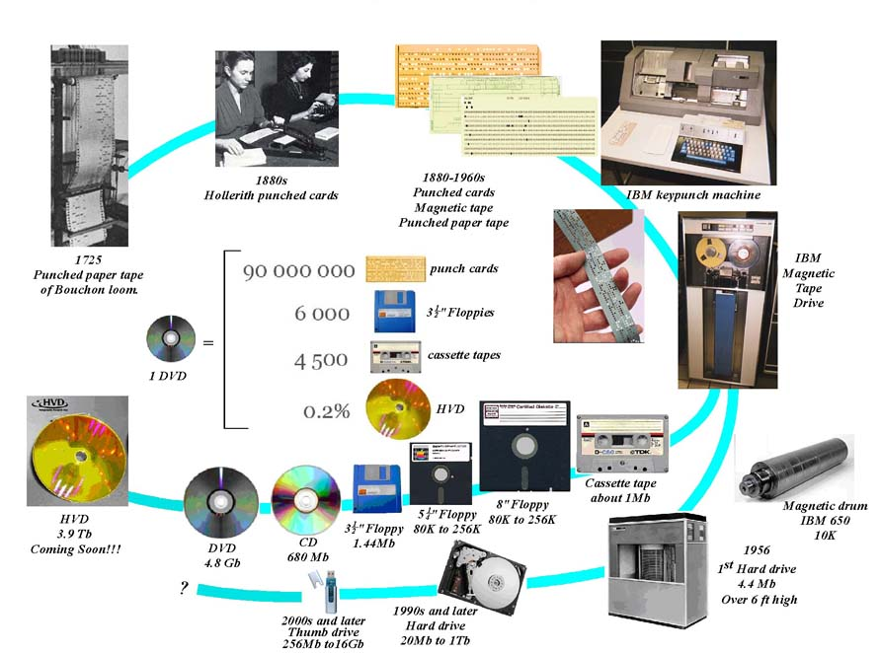
Fig:- Secondary storage devices

Slide 11
Relationship between bit, byte….
8 bits = 1 byte
1024 bytes = 2¹⁰ byte = 1 kilobyte
1024 Kb = 1Mbyte = 2²⁰ byte =1,048,576 bytes
1024 Mb = 1 Gigabyte= 2³⁰ byte = 10,73,741,824 bytes
1024 Gb = 1 Terabyte= 2⁴⁰ byte = 1,099,511,627,776 bytes
1024 Tb = 1 Petabyte = 2⁵⁰ byte = 1,125,899,906,842,624 bytes
1024 Pb = 1 Exabyte = 1,152,921,504,606,846,976 bytes
1024 Eb = 1 Zettabyte = 1,180,591,620,717,411,303,424 bytes
1024 Zb = 1 Yottabyte = 1,208,925,819,614,629,174,706,176 bytes

Slide 12
Memory Hierarchy Pyramid
Processor (CPU)
transfer datapath: bus
Decreasing distance
from CPU, Decreasing Access Time (Memory Latency)
Level 1
Increasing Distance from CPU,
Decreasing cost / MB
Level 2
Level 3
. . .
Level n
Size of memory at each level

Slide 13
Memory Hierarchy
Processor
Control
Secon-
dary
Mem-
ory
Main
Mem-
ory
L2
Cache
Data-
path
L1
cache
regs
Speed(ns): 0.5ns 2ns 6ns 100ns 10,000,000ns
Size (MB): 0.0005 0.05 1-4 100-1000 100,000
Cost ($/MB): -- $100 $30 $1 $0.05
Technology: Regs SRAM SRAM DRAM Disk
Notes:
Instead, the memory system of a modern computer consists of a series of black boxes ranging from the fastest to the slowest.
Besides variation in speed, these boxes also varies in size (smallest to biggest) and cost.
What makes this kind of arrangement work is one of the most important principle in computer design. The principle of locality.
+1 = 7 min. (X:47)

Slide 14
Thanks

